Slide 1

Principles of UI and UX Design
PIXD5112
“People ignore design that ignores people.”
– Frank Chimero
Lecture 14

Slide 2
Objectives
Administration: Where are we in the module?
Today:
- Use wireframes to organise information on an interface and to plan visual hierarchy.
- Activities (designing a wireframe, a look at FIGMA)
Complete: Class Activity
POE: Discuss

Slide 3

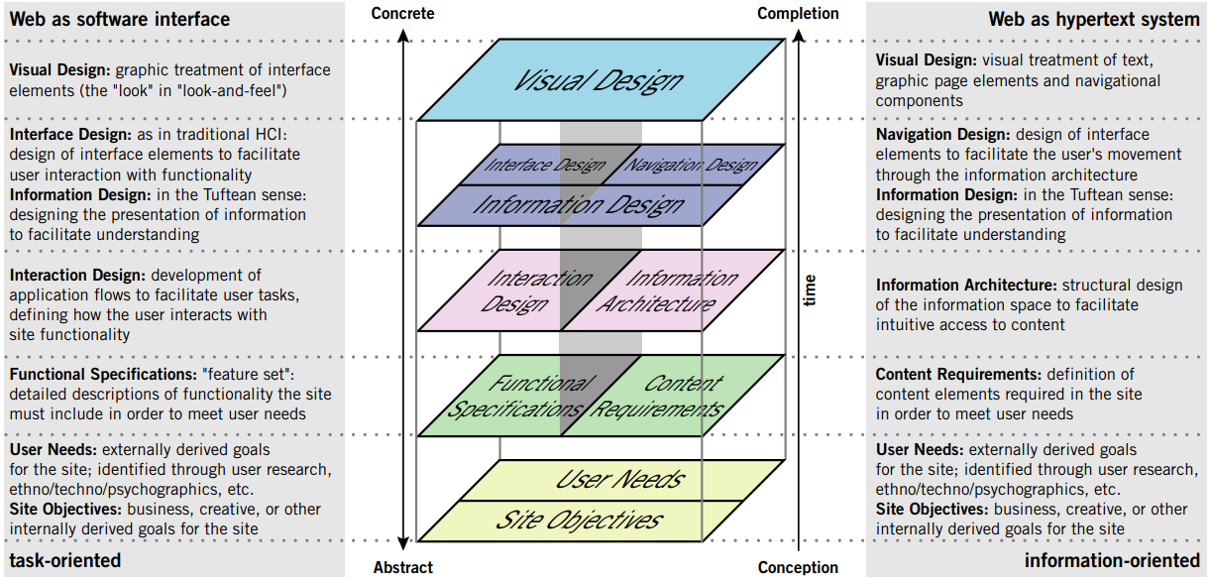
The Elements of User Experience - a basic duality (Garrett, 2000):
4. UX, User Interface and Visual Design
3. Structure
2. Scope
1. Strategy
Resource: Garrett, J. J. 2000. The elements of User Experience. [Online]. Available at: https://hci.stanford.edu/dsc hool/resources/interaction/ garrett-elements.pdf [Accessed 19 August 2022].

Slide 4
The model defines the key considerations that go into the development of user experience on the web today.
Resource: Garrett, J. J. 2000. The elements of User Experience. [Online]. Available at: https://hci.stanford.edu/dsc hool/resources/interaction/ garrett-elements.pdf [Accessed 19 August 2022].

Slide 5
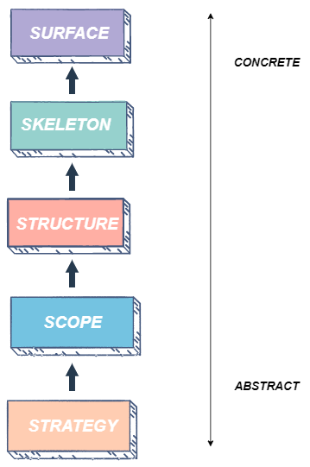
What are the five elements of UX design?
4. Skeleton
This is the fourth layer. The designer puts together the previous pieces to determine the visual form of the design.
Here, the designer decides the flow of information and movement from one screen to the next.
The designer makes sure that navigation is smooth and the presentation of information facilitates user understanding.
Source: https://www.educative.io/answers/what-are-the-five-elements-of-ux-design

Slide 6
Getting started with your POE – PART 2

Slide 7
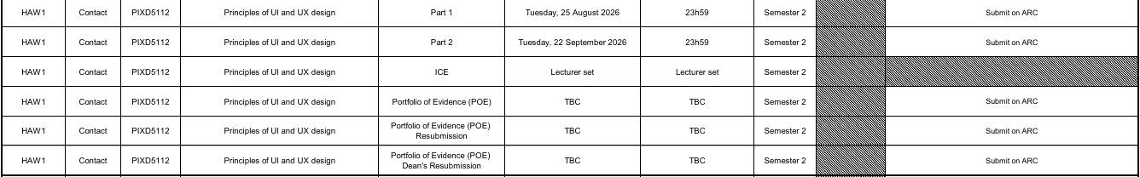

Slide 8
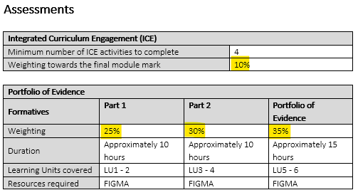

Slide 9
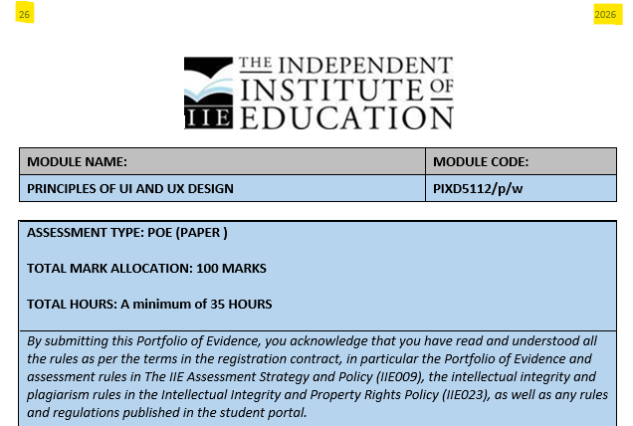

Slide 10
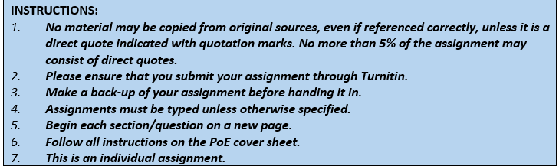

Slide 11
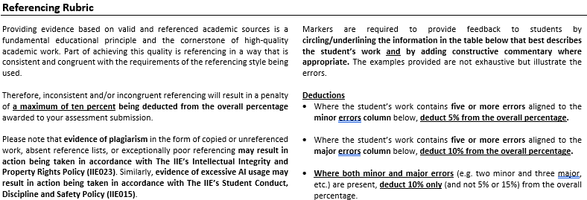

Slide 12
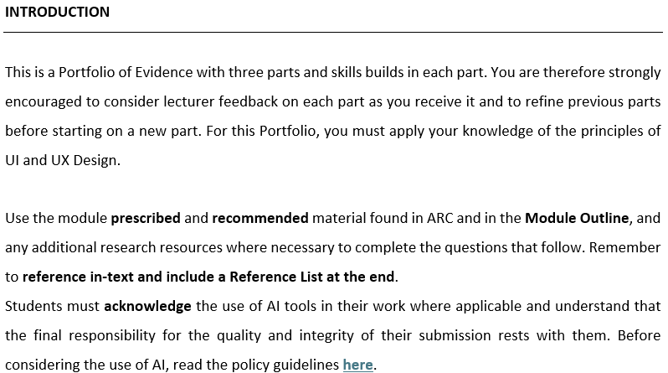
https://irp.cdn-website.com/3f7b6868/files/uploaded/PDIIE023+Guidelines+for+Responsible+AI+Use+at+The+IIE+2026.pdf

Slide 13
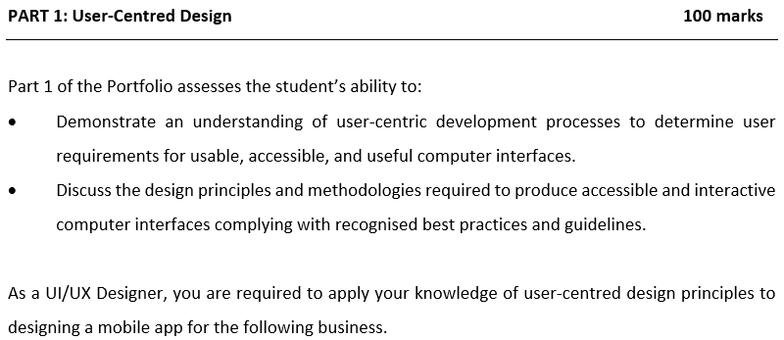

Slide 14
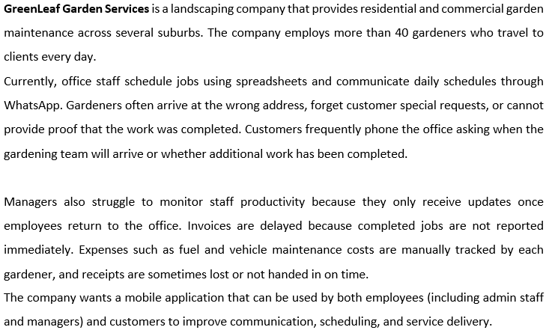

Slide 15
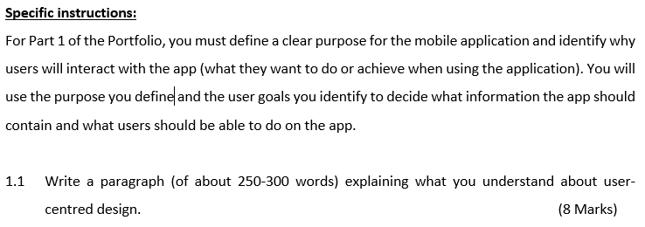

Slide 16
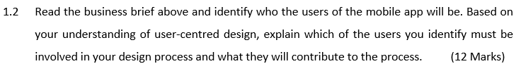

Slide 17
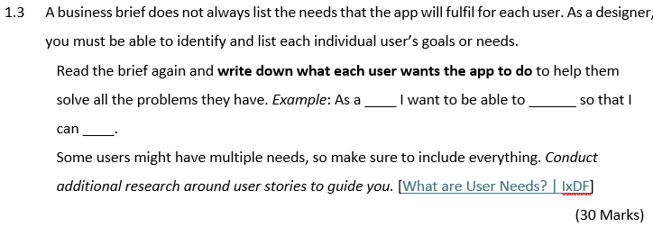

Slide 18
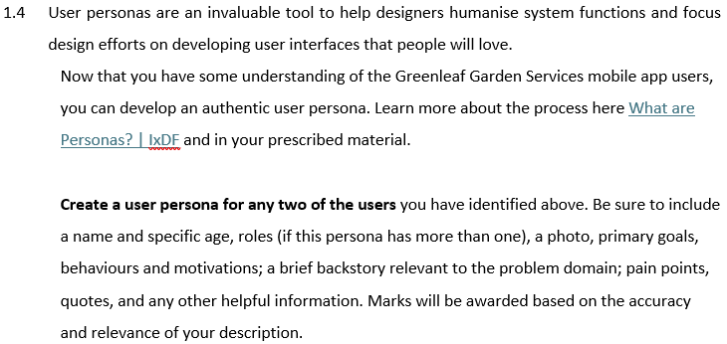
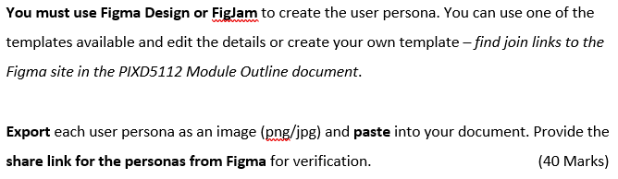

Slide 19
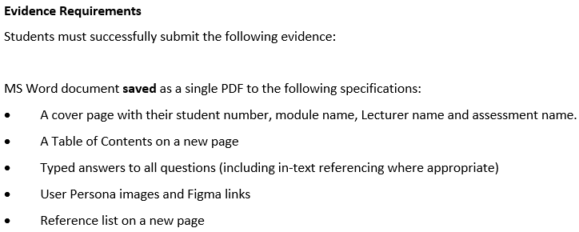

Slide 20
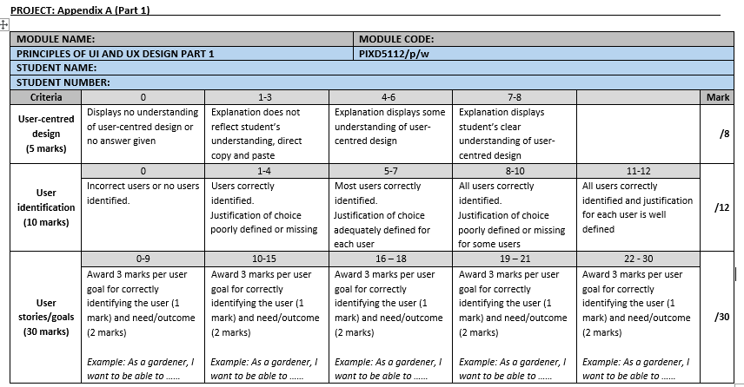

Slide 21
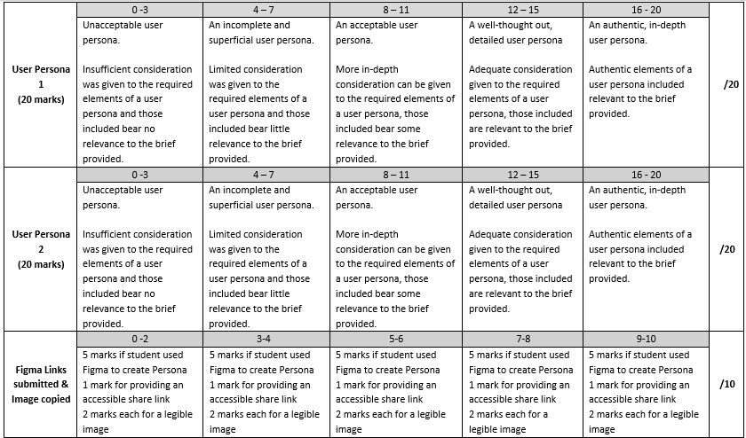

Slide 22
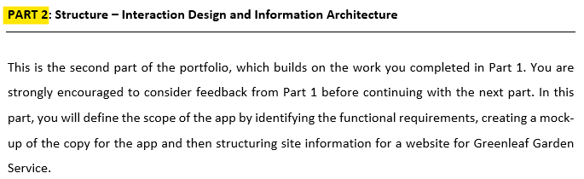

Slide 23
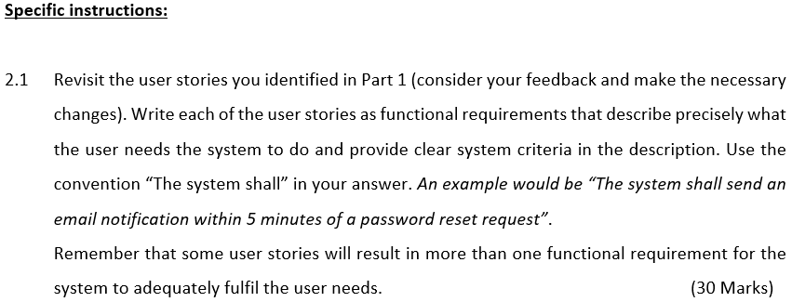

Slide 24
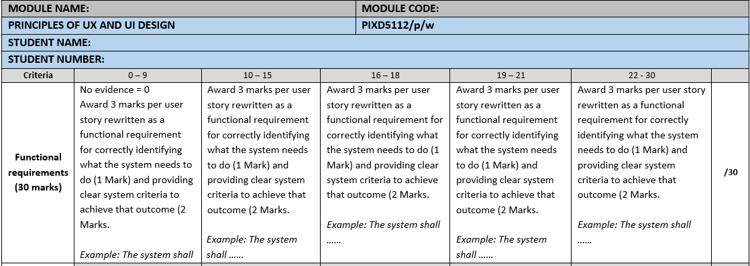

Slide 25
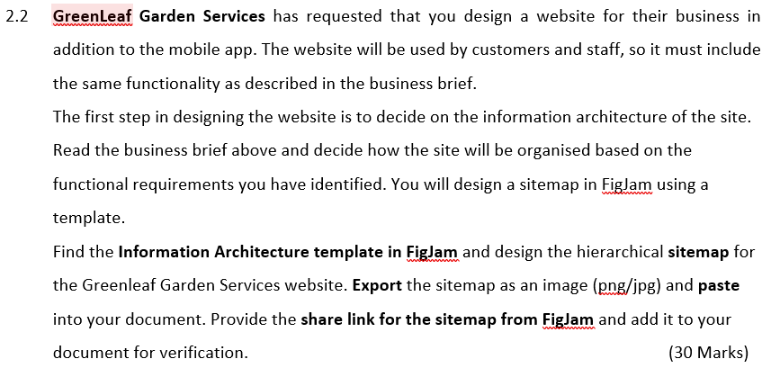

Slide 26
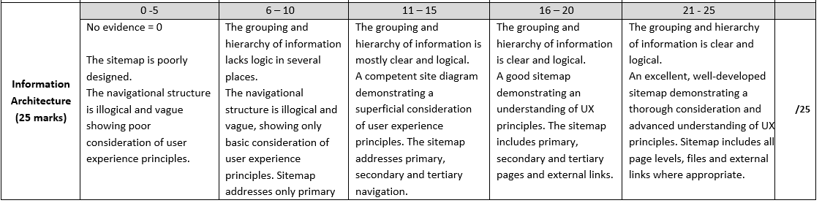

Slide 27
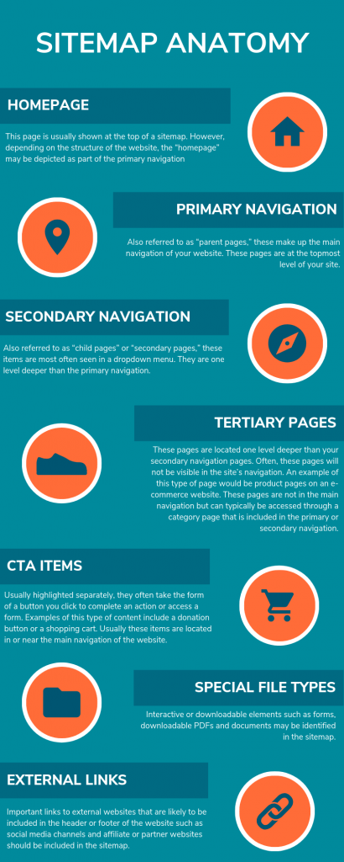
A Call To Action or CTA is a prompt that tells your audience to take some specified action.
It can be a command or action phrase, such as 'Sign Up' or 'Buy Now' and takes the form of a button or hyperlink.
Resource: https://www.oneupweb.com/blog/sitemaps-101-introduction-sitemapping-website/

Slide 28
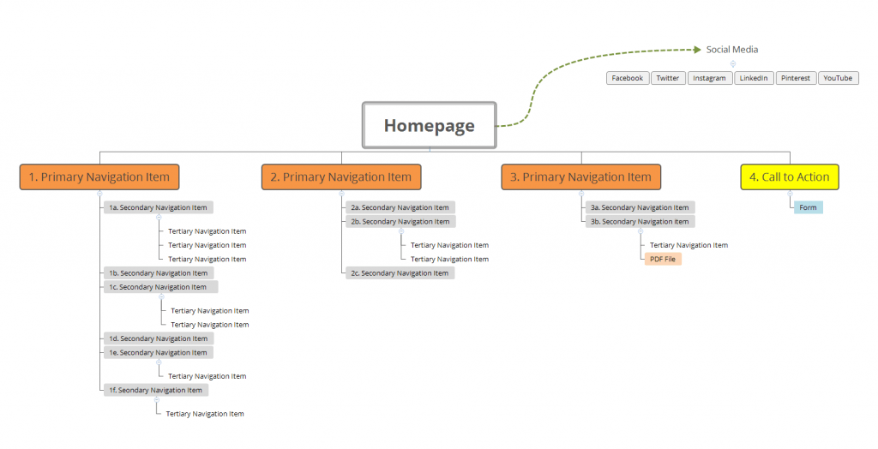
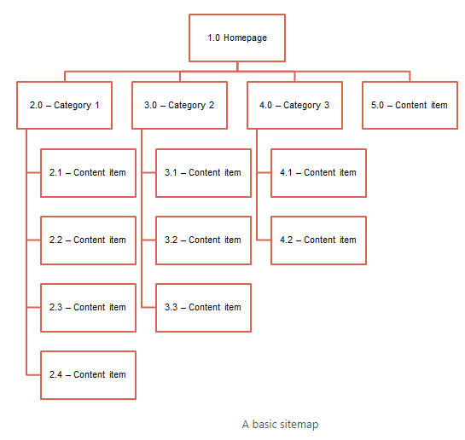
Resource: https://www.oneupweb.com/blog/sitemaps-101-introduction-sitemapping-website/

Slide 29
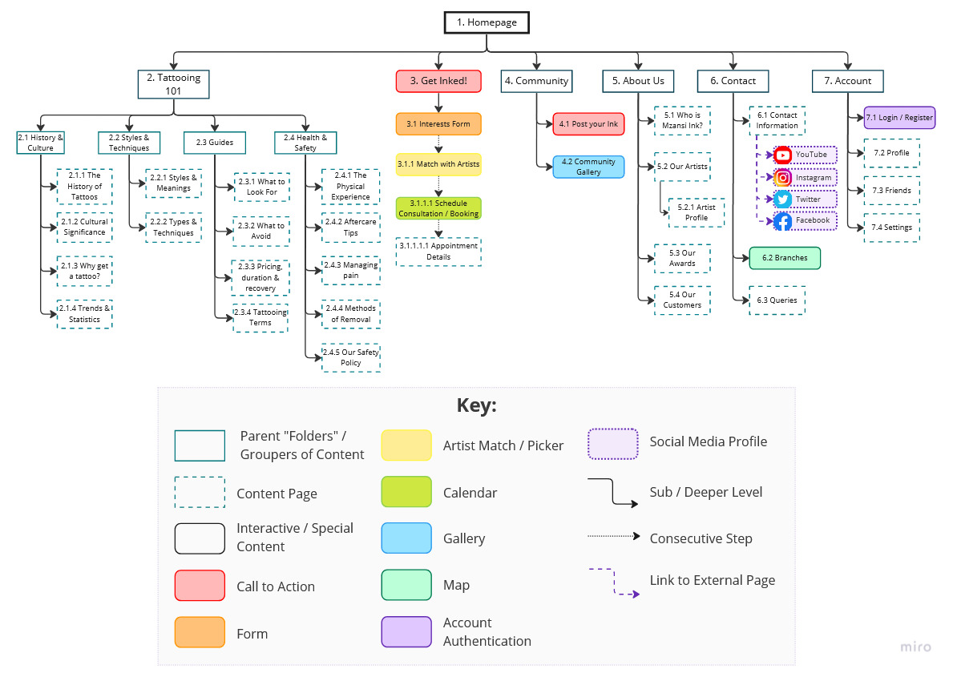

Slide 30
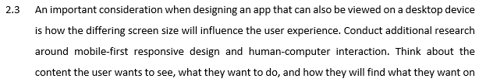
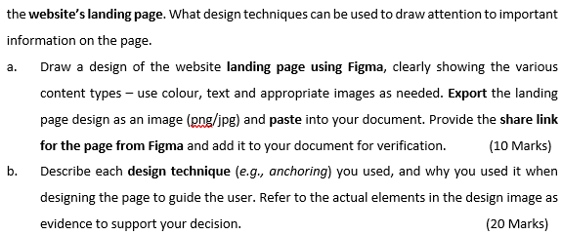

Slide 31
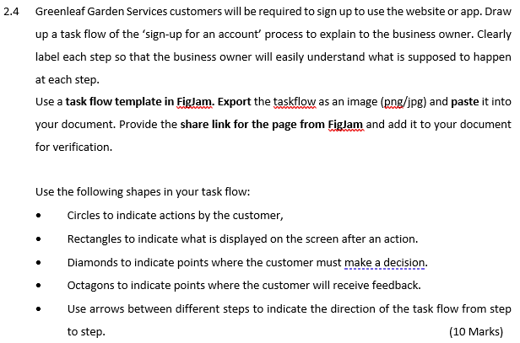

Slide 32
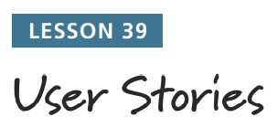
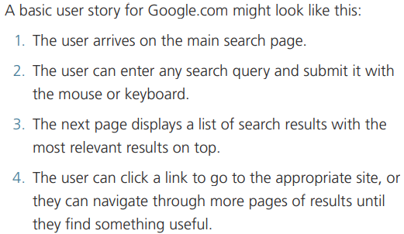
A user story describes one possible path a user can take in your site or app. It should be short, but complete. You will need many user stories to describe your whole design.

Slide 33
Actions (by user)
Displayed on screen (after an action)
Decision
Feedback

Slide 34
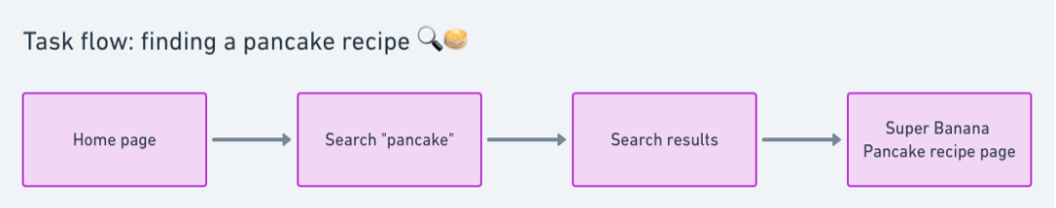
Task flow represents the user's actions when they complete a specific task.
Usually, task flows illustrate only one path without multiple ways.
Task flows are used in UX design when you think that all clients will take the same sequence of steps.
Source: https://www.eleken.co/blog-posts/ux-flow-and-its-importance-for-the-design-process

Slide 35
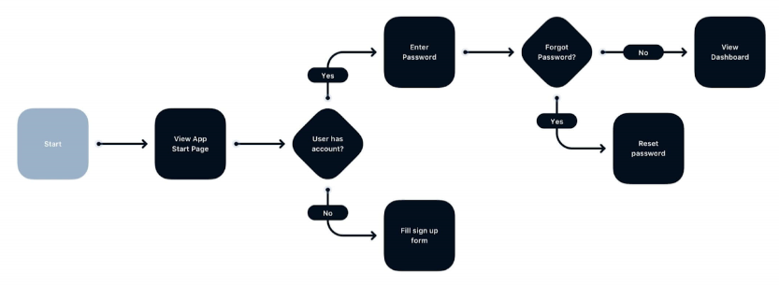
Example of a Task Flow
Source: https://www.eleken.co/blog-posts/ux-flow-and-its-importance-for-the-design-process

Slide 36
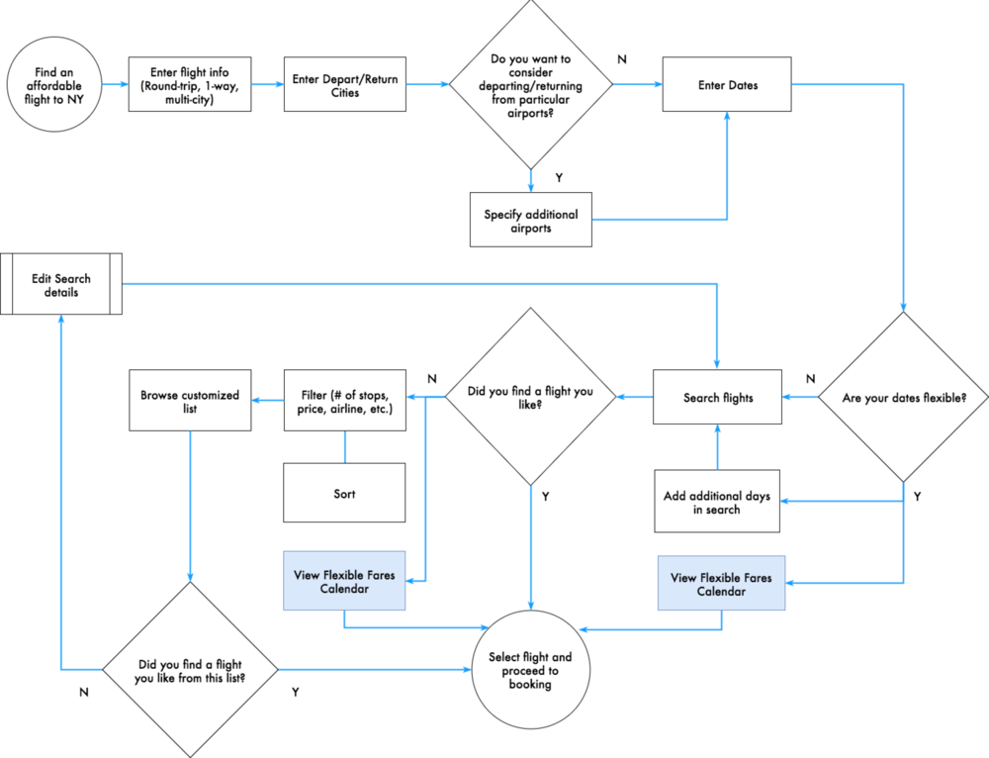
Task Flow for an Airplane Ticket
Source: https://www.seekpng.com/ipng/u2e6o0y3e6i1a9i1_task-flow-task-flow-airplane-ticket/

Slide 37
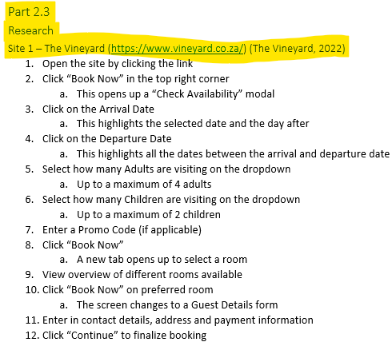
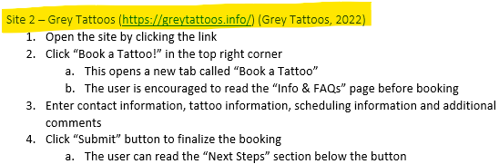

Slide 38
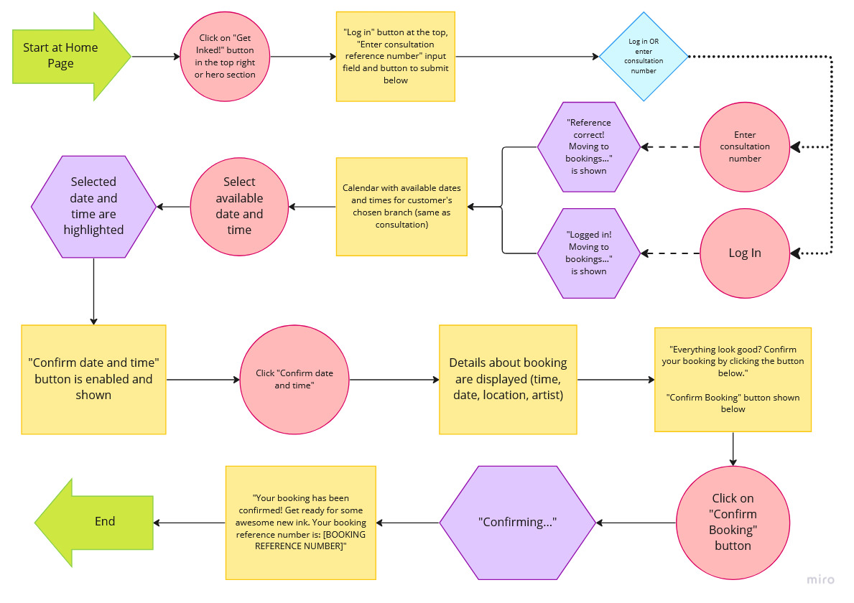

Slide 39
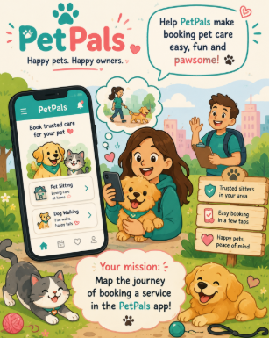
TASK: Design a Task Flow for "Book a Service" Process
Background: You are the UX designer for "PetPals" – a new mobile app that connects pet owners with local pet sitters and dog walkers. The business owner wants to understand how customers will book a service through the app.
You need to create a task flow that visually explains this process to the business owner.
Instructions:
Draw up a task flow of the 'Book a Service' process to explain to the business owner. Clearly label each step so that the business owner will easily understand what is supposed to happen at each step.
Use the following shapes in your task flow:
Shape | Represents
Circles | Actions by the customer
Rectangles | What is displayed on the screen after an action
Diamonds | Points where the customer must make a decision
Octagons | Points where the customer will receive feedback
Arrows | Direction of the task flow from step to step

Slide 40
Process Steps to Include (Your task flow must cover these actions):
Customer opens the PetPals app
Customer browses available pet sitters/walkers
Customer selects a sitter/walker
Customer chooses a date and time for the service
System checks if the sitter is available
(Decision Point) – Is the sitter available?
  If YES → Customer confirms the booking
  If NO → Customer is shown alternative sitters and must select again
Customer enters pet details and special instructions
Customer confirms the booking
System processes the booking
Customer receives booking confirmation
Use a task flow template in FigJam.
Export the task flow as an image (png/jpg) and paste it into your document.
Provide the share link for the page from FigJam and add it to your document for verification.

Slide 41
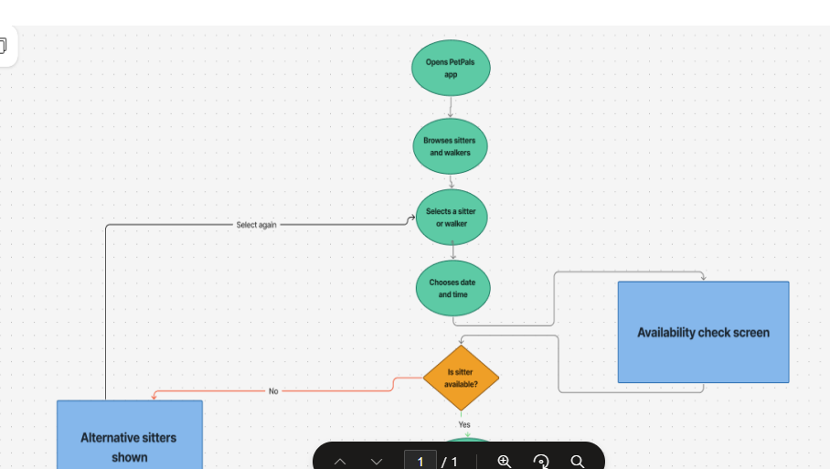
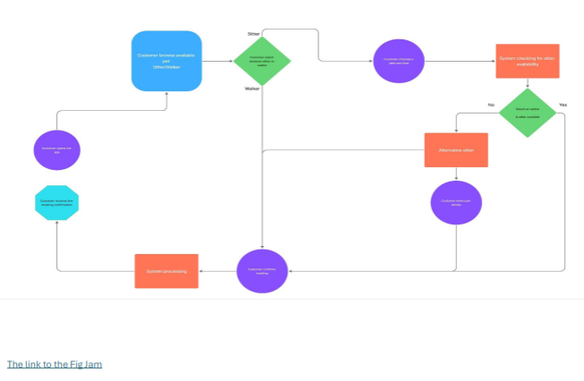
Email your task flow to: bvdmerwe@emeris.ac.za

Slide 42
The Elements of User Experience - a basic duality (Garrett, 2000):
4. UX and User Interface and Visual Design
3. Structure
2. Scope
1. Strategy
Resource: Garrett, J. J. 2000. The elements of User Experience. [Online]. Available at: https://hci.stanford.edu/dsc hool/resources/interaction/ garrett-elements.pdf [Accessed 19 August 2022].

Slide 43
The model defines the key considerations that go into the development of user experience on the web today.
Resource: Garrett, J. J. 2000. The elements of User Experience. [Online]. Available at: https://hci.stanford.edu/dsc hool/resources/interaction/ garrett-elements.pdf [Accessed 19 August 2022].

Slide 44
What are the five elements of UX design?
4. Skeleton
This is the fourth layer. The designer puts together the previous pieces to determine the visual form of the design.
Here, the designer decides the flow of information and movement from one screen to the next.
The designer makes sure that navigation is smooth and the presentation of information facilitates user understanding.
Source: https://www.educative.io/answers/what-are-the-five-elements-of-ux-design

Slide 45
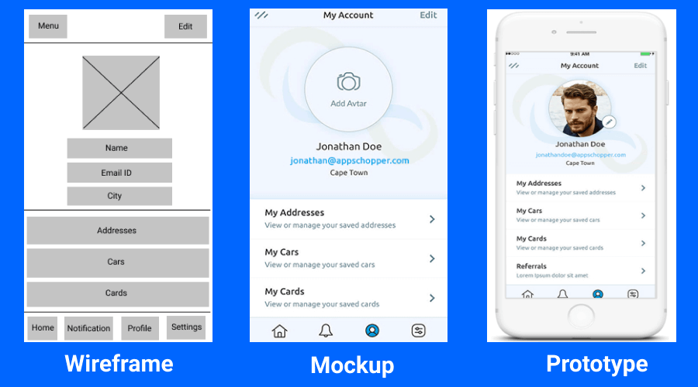
What should a wireframe look like?
Most wireframes are essentially black and white diagrams with various UI elements and notes upon them. In most cases they should be devoid of imagery, branding and colour (aside from links/call outs).

Slide 46
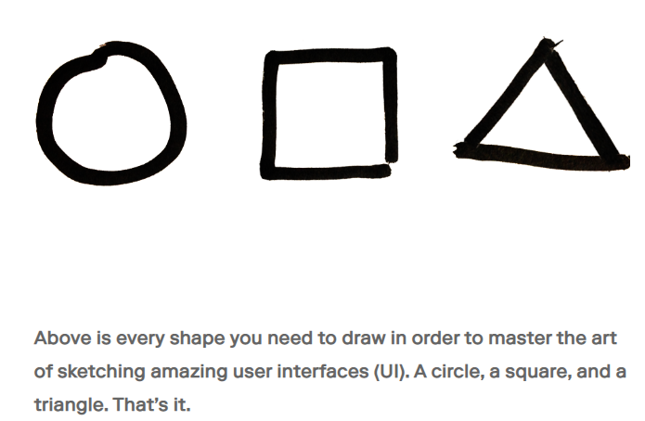
Wireframe Software Symbols
Source: https://rangle.io/blog/master-ui-wireframes-with-only-three-shapes/

Slide 47
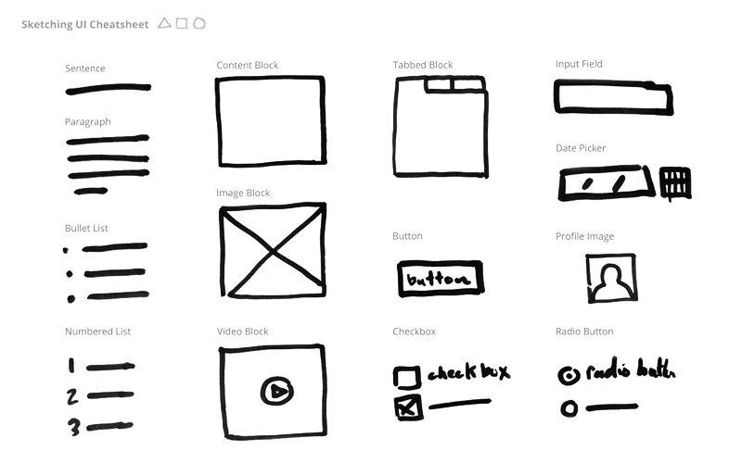
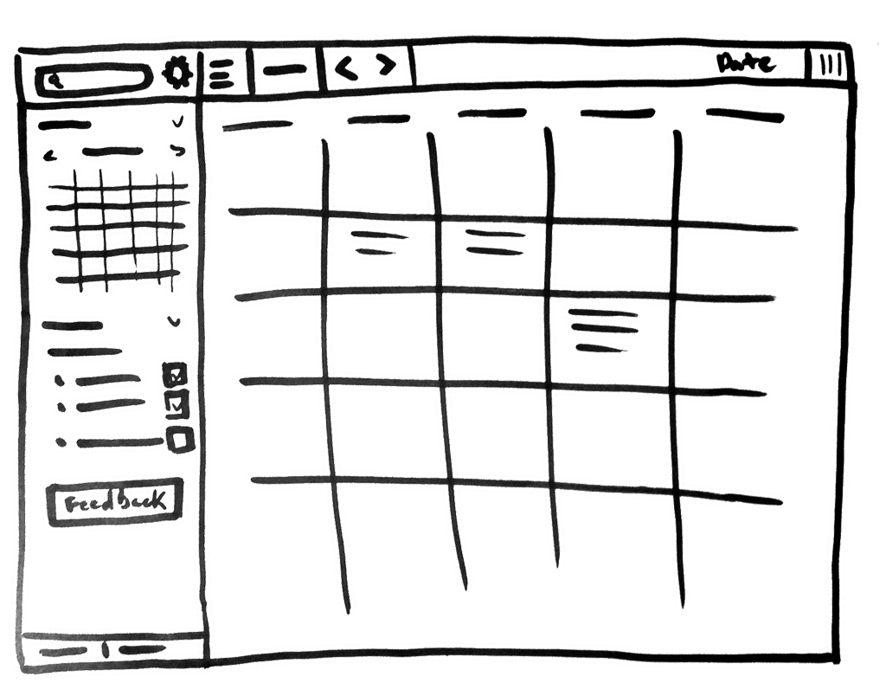
Wireframe Software Symbols
Source: https://rangle.io/blog/master-ui-wireframes-with-only-three-shapes/

Slide 48
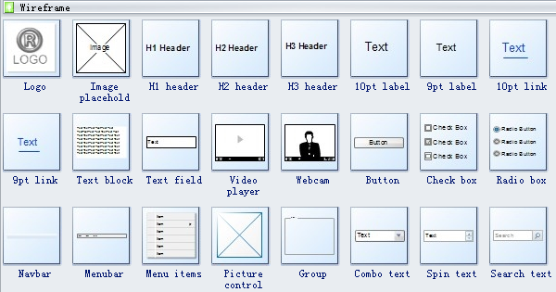
Wireframe Software Symbols
Source: https://www.edrawsoft.com/wireframe-software-symbols.html

Slide 49
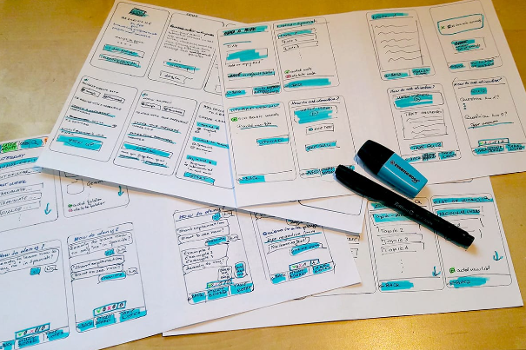
Very basic Wireframe Example:
Source: https://careerfoundry.com/en/blog/ux-design/what-is-a-wireframe-guide/

Slide 50
Wireframe vs Prototype vs Mockup

Slide 51
Wireframe vs Prototype vs Mockup
Wireframes
A wireframe is the most basic and visual representation of the app design. They are just black and white renderings that focus on what the app or feature will do. Simply put, a wireframe is a basic draft or a sketch by app designers. The purpose of wireframes is to show the structure of an app with basic elements and content placement.
Mockups
A mockup is the next step and also one step ahead of wireframes. Even though it’s not interactive and not clickable, it’s a graphic representation of an app design. With mockups, you can see shapes, fonts, and the color palette.
Prototype
A prototype is a high-fidelity interactive representation of the final product. It’s basically a working model of an app. It’s like a mockup enriched with UX pieces and interactions, it looks like an actual app. The best thing about prototypes is it lets app designers test the user journey.

Slide 52
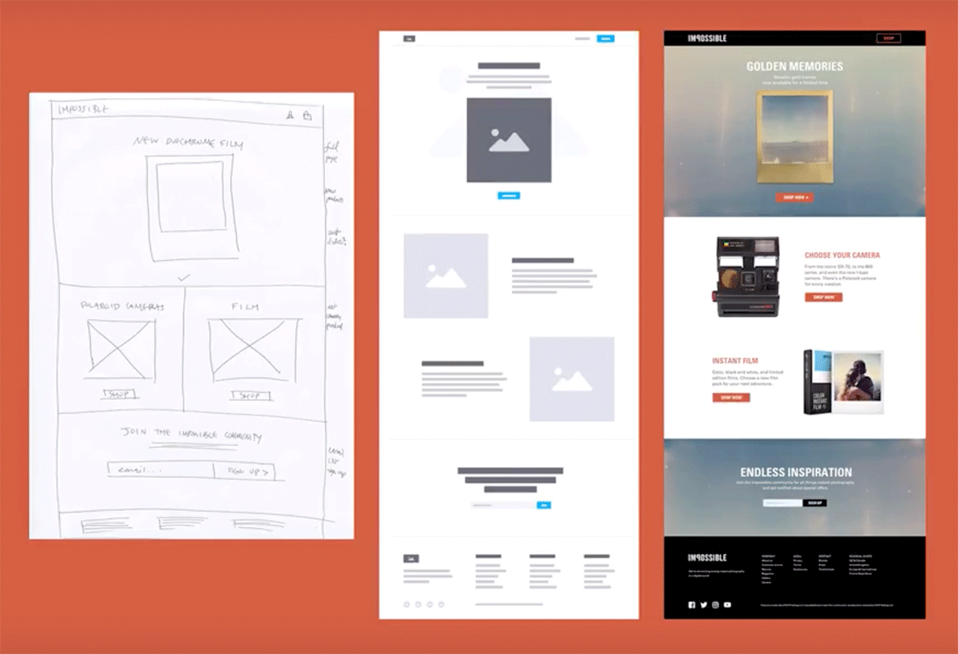
Wireframe to Prototype Example:
Source: https://careerfoundry.com/en/blog/ux-design/what-is-a-wireframe-guide/

Slide 53
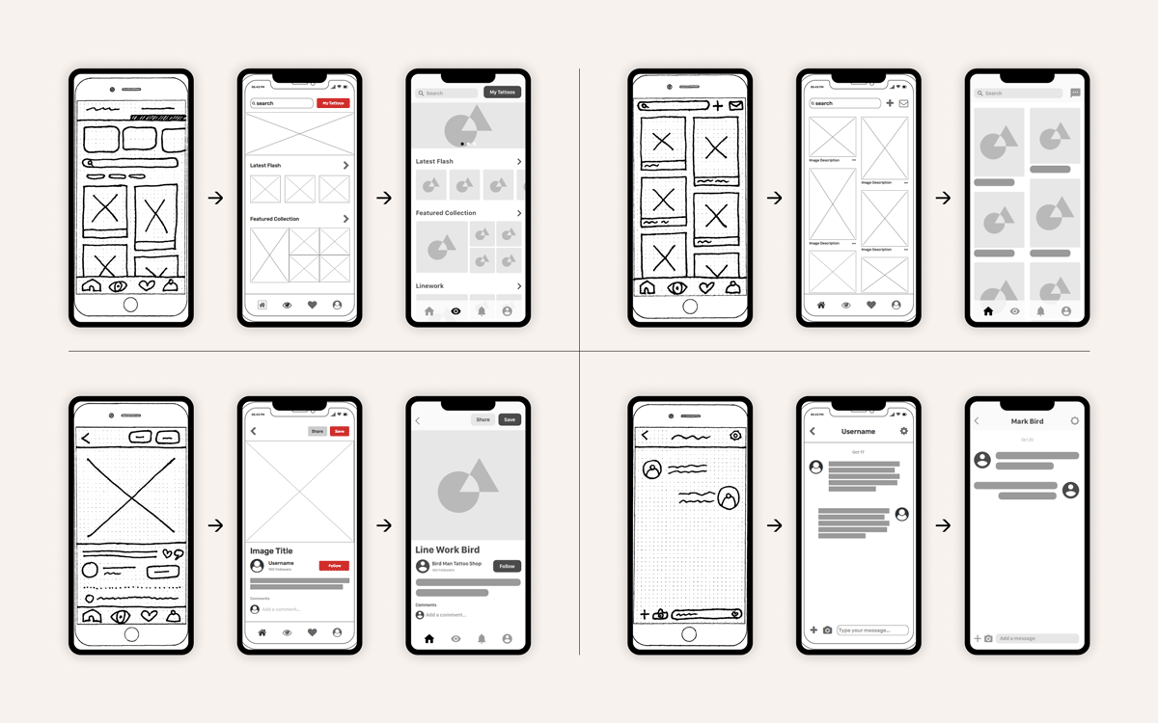
Wireframe to Prototype Example:
Source: https://careerfoundry.com/en/blog/ux-design/what-is-a-wireframe-guide/

Slide 54
Activity 1
Creating a Wireframe for a Login Screen (Phone screen/App)

Slide 55
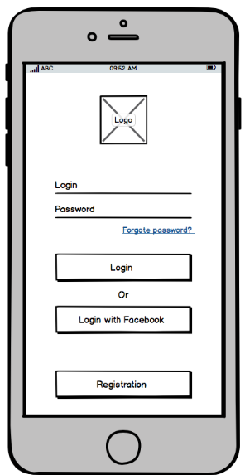


Activity 1
Creating a Wireframe for a Login Screen (Phone screen/App)

Slide 56

Activity 1
Creating a Wireframe for a Login Screen (Phone screen/App)

Slide 57
Activity 2
Digitizing your Wireframe (using Figma)

Slide 58
Activity 3
UX Design Challenge: From User Story to Screen
For this part of the portfolio, you will transform the user task flow you developed in the previous lecture into a set of low-fidelity mobile app screens.
The goal is not simply to draw screens, but to demonstrate how you have organised information, prioritised content and designed an interface that allows a user to complete a specific task easily.
The Challenge
Work with the follow user task:
Booking a service
Design the interface that allows your user to successfully complete this task.

Slide 59
Specific Instructions
Step 1: Design on Paper
Before opening Figma, create three hand-drawn screen sketches showing the user's journey through the selected task.
Your three screens must show:
Screen 1 – Start
Where does the user begin the task?
Screen 2 – Action
What does the user need to do or decide?
Screen 3 – Outcome
What happens when the task has been completed?
For example:
Pet-sitting app:
Find a pet sitter → Select a sitter → Confirm booking
Your sketches should focus on layout and functionality, rather than artistic quality.

Slide 60
Step 2: Build Your Wireframes in Figma
Use your sketches as a starting point to create three low-fidelity wireframes in Figma.
Your wireframes must demonstrate:
a. Content hierarchy
Show which information is most important and how the user should naturally move through the screen.
b. Navigation
Include buttons, menus, links, back buttons or other navigation elements required to move through the task.
c. Functionality
Represent interactive elements such as:
Search
Buttons
Forms
Filters
Dropdowns
Checkboxes
Images/placeholders
Cards
Notifications
Confirmation messages
d. Branding
Include the app's name/logo or an appropriate placeholder representing the brand identity.
e. User feedback
Show how the interface communicates what has happened after an action.
For example:
“Booking Confirmed”
✓ Your booking has been successfully submitted.

Slide 61
Step 3: Make Your Design Decisions
Under your three Figma wireframes, briefly explain three important design decisions you made.
For each decision, explain:
What you changed or included.
Why you made the decision.
How it helps the user complete the task.
For example:
Decision 1: Confirmation button
I placed the “Confirm Booking” button at the bottom of the screen because it is the final action the user needs to take. This makes the next step clear and reduces confusion.

Slide 62
Step 4: Test Your Wireframe
Ask one other person to look at your three wireframes.
Without explaining the design to them, give them the following instruction:
“Using these screens, show me how you would complete this task.”
Observe where they hesitate or become confused.
Briefly record:
What they struggled with
What you changed
Why you made the change
This demonstrates that your design is based on usability rather than simply what looks good.

Slide 63




Low Fidelity VS Medium Fidelity VS High Fidelity
Source: https://www.sketch.com/blog/wireframe-examples/

Slide 64
Wireframe Design Challenge
Goal: Design 4 types of wireframes for an app or website of your choice - something you're passionate about.
Your Task:
Choose a concept you love (e.g., sneakers, gaming, food, travel, music).
Create a purchase or booking flow with at least 3 pages (e.g., Home → Product/Service → Checkout/Booking).
4 Stages:
Paper Wireframes – Sketch rough layouts by hand. Focus on structure, not details.
Low-Fidelity – Digital, grayscale boxes and placeholders. Basic layout only.
Medium-Fidelity – Add real text, images, buttons, and navigation. Refine spacing.
High-Fidelity – Full color, branding, typography, and interactive elements. Polished and clickable.
Deliverable:
All 4 stages showing your 3+ page flow from landing page to completed purchase/booking.
Tips:
Decide early: app or website?
Keep the user journey clear at every stage.
Show how each stage improves on the last.
Passion drives better design. Pick something you'd actually use.

Slide 65
Previous ICE TASKS
ICE TASK 1, 2 and 3

Slide 66


ICE TASK 1
Due Date: 29/07/2026
On Brightspace complete the Quiz
Go to:
Complete:

Slide 67


ICE TASK 2
Due Date: 14/08/2026
On ARC complete the following Activity:
Go to:
Complete:

Slide 68



ICE TASK 2
Due Date: 14/08/2026
On ARC complete the following Activity:

Slide 69

ICE Task 3 - Designing a Site Map
Due Date: 01/09/2026
Instructions:
Select a website (based on an interest) that you wish to analyze in terms of designing and developing a site map.
Carefully examine the website in terms of names of the different categories and content items.
Create a site map in the form of a tree diagram to organise and structure different groups of information topics. You may create your sitemap using the drawing or smart art tools in your word processing software, any other available online diagram tools. Your site map must indicate the names of the different categories and content items. Do NOT just use generic headings as in the example in this article (As indicated on the previous slide).
Paste the image of your sitemap when submitting your ICE task on ARC.
  Click on Assessment, then ICE Task 3 to submit
Your sitemap provides the initial definition for what you are going to be delivering along with the first steps of defining the interface (the navigation). You can reference it in sitemaps, content strategies and functional specifications and it’s also a great way to show to the client what you are planning to build them.

